Slide 1
Saponins glycosides
Lect. A.T. pharmacsit Nour Hameed Aldhif

Slide 2
Saponins glycosides
Saponins are glycosidic compounds that are produced as secondary metabolites. Structurally, saponins consist of an aglycone (sapogenin) attached to one or more sugar chains.
Hydrophobic _Hydrophilic
(aglycone) (sugar)

Slide 3
Saponins classification
According to their aglycone composition as:
Triterpene glycosides (30)
Steroid glycosides(27)

Slide 4
We concern in this lab. with two plants:
Liquorice
Fenugreek

Slide 5
Triterpene glycosides : Liquorice

Slide 6
Botanical origin
Scientific name: Glycyrrhiza glabra Linn
Family: Leguminosae
Active part; Roots and Rhizome

Slide 7
Chemistry
The chief constituent of liquorice root is Glycyrrhizin
Flavonoids (liquiritin and isoliquiritin ).
Sugar
20% Starch
Gum, protein, fat ,resin, trace of tannin , and of volatile oil

Slide 8
Medical uses
Flavoring agents
Sweetener
An expectorant
It has a well-documented reputation for healing ulcers.
Anti-inflammatory
Glycyrrhiza liquorice appears to have modest glucocorticoid activity .(H.W)

Slide 9
Contra- indication
why????
Pregnant women
People with high blood pressure, kidney disease

Slide 10
Drug products containing liquorice:
??????

Slide 11
Stroidal glycosides: Fenugreek

Slide 12
Botanical origin
Scientific name: Trigonella-Foenum Graecum
Family : Fabaceae
Active part : The seeds

Slide 13
chemistry
Steroidal saponins
B vitamins
Flavonoids
Alkaloids
Coumarins
Mucilage

Slide 14
Medical uses
Treating digestive proplems
Stablize blood glucose levels
Antihypertensive
Decreasing blood cholesterol
Dose dependent neuroprotective and antiapoptotic effects
Women who are breast-feeding sometimes use fenugreek to promote milk flow

Slide 15
Identificaion of triterpenoids

Slide 16
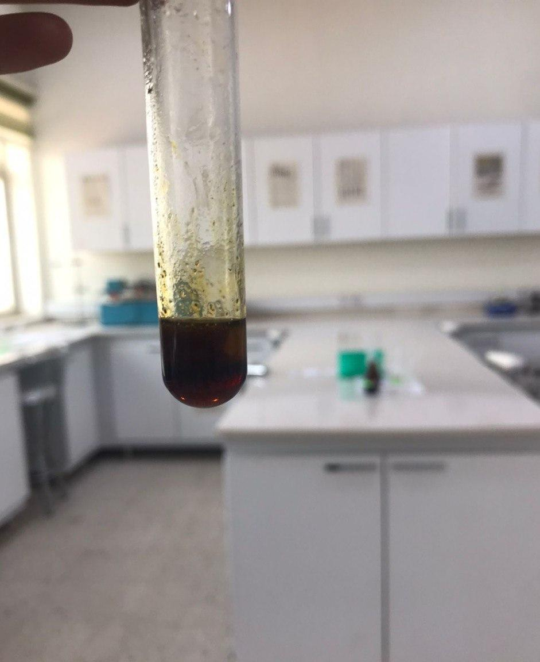
Results
A
B
C

Slide 17
Extraction of steroidal glycosides
10 gm of fenugreek seeds + 200 ml D.W + 10 drops HCL decoction for 15 min.
Filter and take 10 ml from extract and transfer to separatory funnel.
Add 10 ml from chloroform and shaking then let it stand then collect chloroform layer

Slide 18
Identify the sterol nucleus
Lieberman's Sterol Reaction:
Take 1ml of chloroform layer in a test tube then add 5ml of anhydrous acetic acid and shake well.
Take 4 drops of the above mixture and place in a other test tube or beaker, and then add one drop of conc.H2SO4.

Slide 19
Results
A change of color from rose, through red,violet and blue to green. The colors are slightly different from compound to compound

